Slide 1
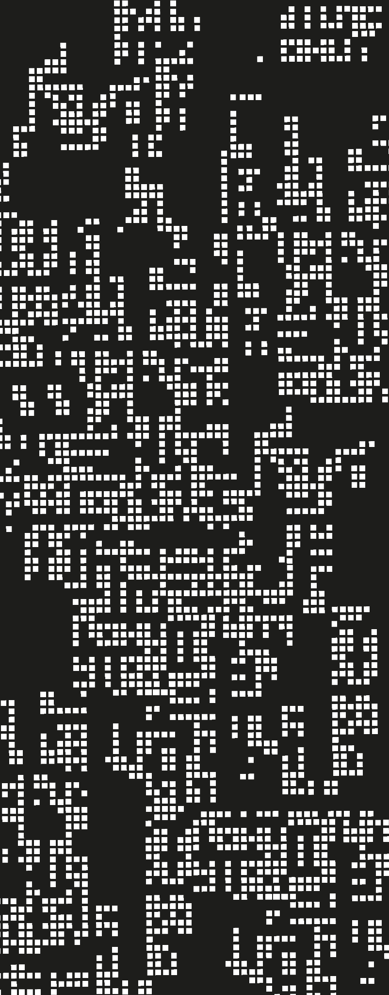
Buy Now Pay Later Project
Group 15

Slide 2
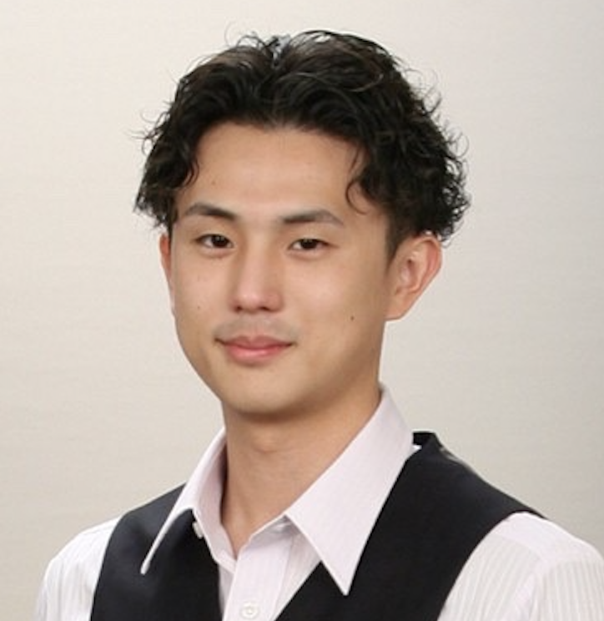
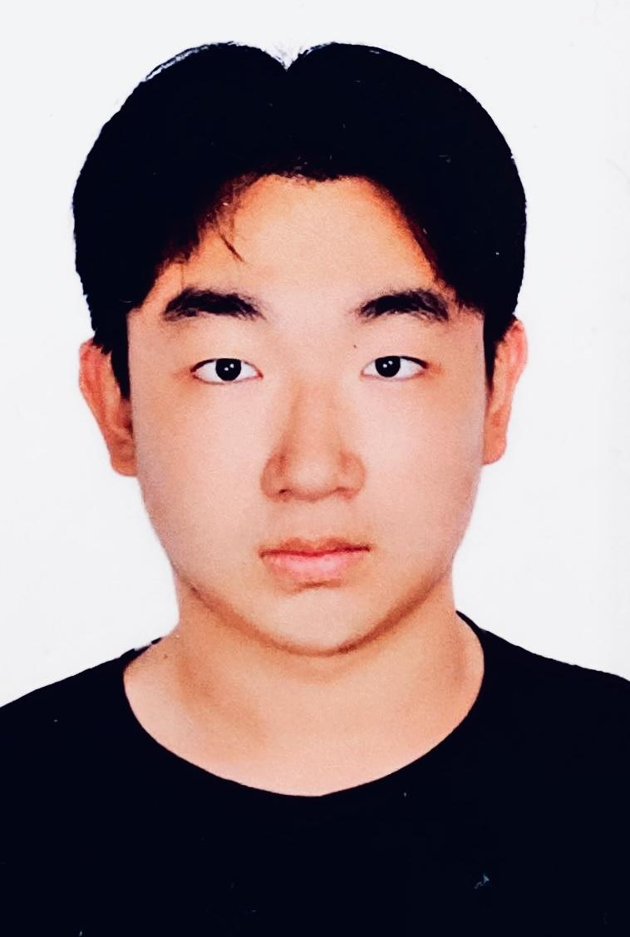
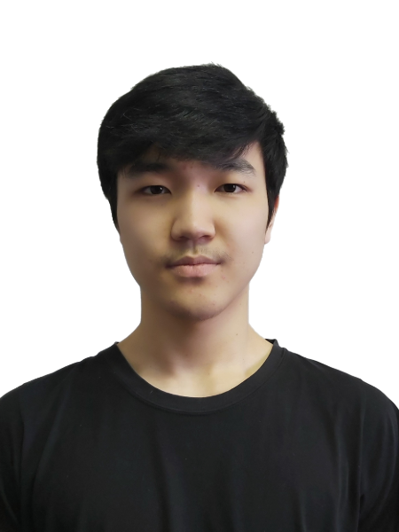
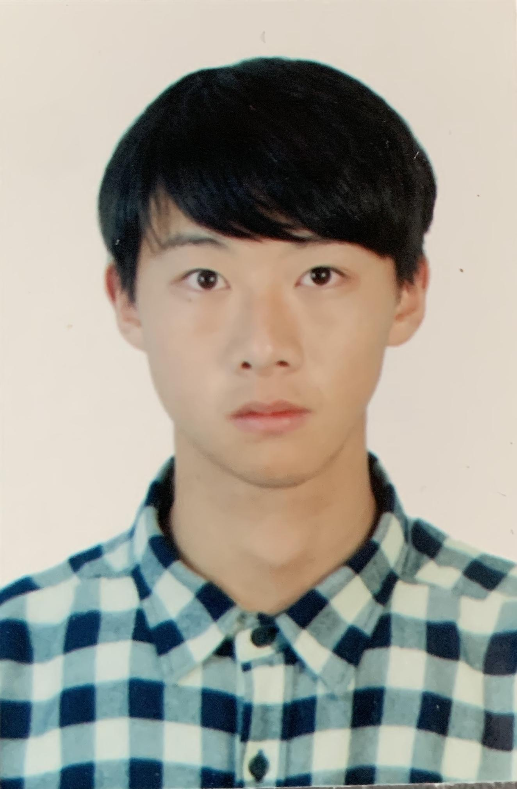
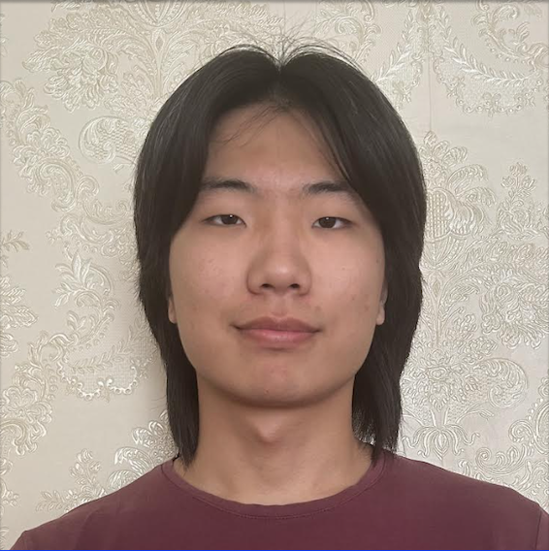
Our team
Keigo Warashina
Beibei Zhu
Ider Byambadorj
Zihan Xu
Tugsgerel Lkhagvasuren

Slide 3
Project Recap
The Buy Now Pay Later (BNPL) Firm has begun offering a new “Pay in 5 Installments” feature and is going to onboard 100 merchants every year.
This project focuses on these tasks:
Assess the given and external datasets
Construct models to predict merchant’s features
Find best 100 merchants to trade with

Slide 4


Project Timeline
Steps |  |  | Sprint | 1 | 2 | 3 | 4 | 5 | 6 | 7
1. Preliminary Analysis - 15h
2. Outlier Analysis - 10h
3. Geospatial Visualizations - 10h
4. Feature Engineering - 10h
5. Modelling - 25h
6. Ranking System - 20h
7. Result Analysis - 20h
8. Prepare Presentation - 10h
Preprocessing
Modelling
Interpretation and Discussion

Slide 5
Security and Privacy
Storage
Access
Privacy
All data is stored in a private Github repository
Only group members accessed the data from their local, privately secured devices
All data is confidential. No API keys were utilized.

Slide 6
Table of contents
01
Datasets
02
Modelling
03
Ranking system
04
Result & Recommendation

Slide 7
Datasets
01

Slide 8
Datasets
Transactions data
Merchant details
Consumer details
Fraud data
≈14,000,000 instances of transaction between merchants and their consumers, from Feb 2021 to Aug 2022
Total of ≈4,000 merchants, all having different take rate.
≈500,000 consumers were registered. Attributes include consumers’ postcode and gender.
≈4,000 and ≈80,000 data points indicating merchant and consumer fraud probabilities.

Slide 9
External datasets
Demographic data
Income data
Population
Population density
Median age
Median income
Sum income

Slide 10
Data Pipeline
Data Ingestion
Extract and Load the dataset
Preprocess
Transformation and Aggregation
Preliminary analysis
Visually assess the data
Modelling
Train statistical models to predict 2023 data and fraudulent transactions
Rank
Rank the merchants using Weighted Sum Method.

Slide 11
Preprocess: Missing values analysis
No details found for ≈400 merchants out of 4000 merchants
Likely to be not our clients
Removed those merchants and their corresponding transactions

Slide 12
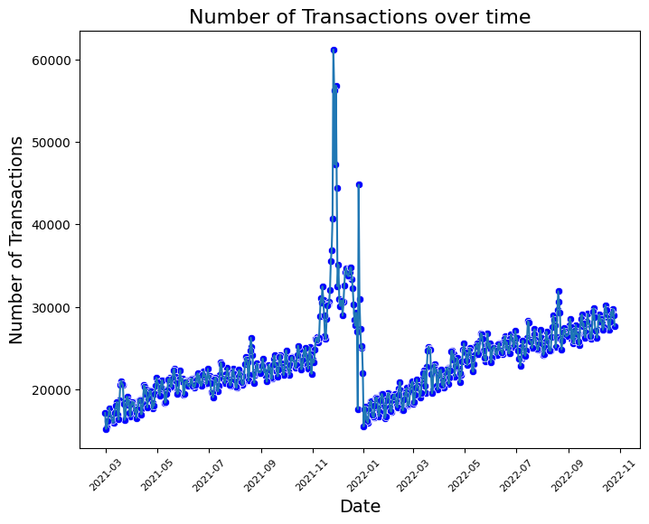
Preliminary analysis: transaction data
Spike in demand during holiday season, from November to January
Observations:
Similar trend each year
High volume of transactions during Christmas and the Summer Holiday

Slide 13
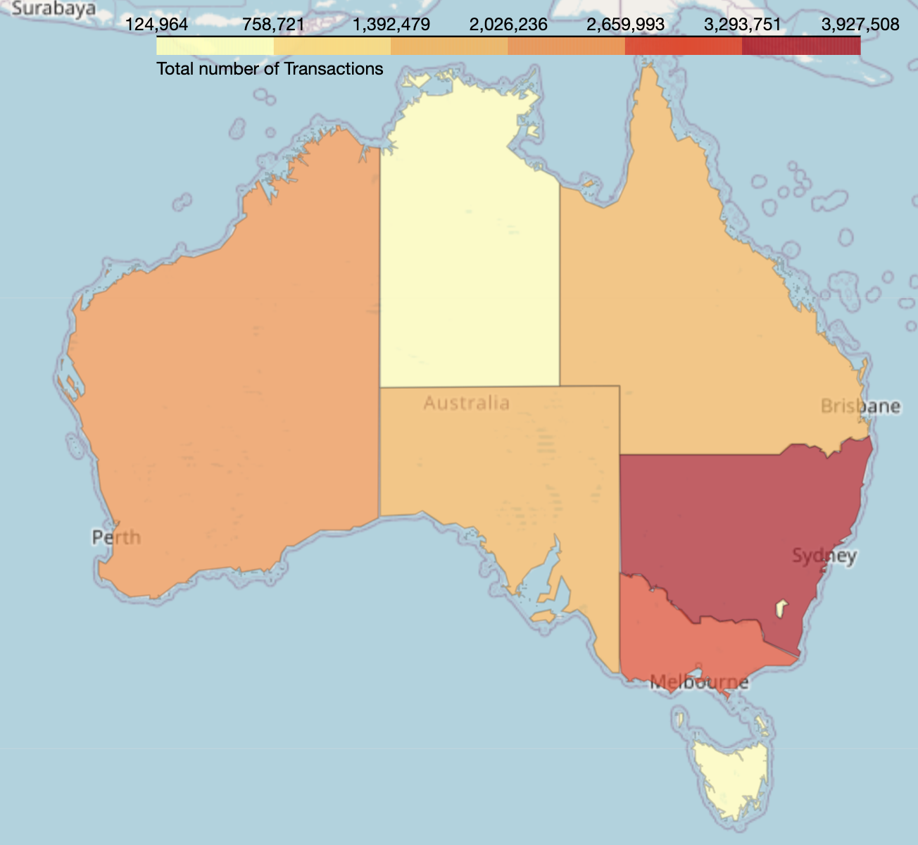
Geospatial Analysis: Number of Consumers by state
Observations:
→ New South Wales and Victoria have the highest number of consumers
→ Potential benefit to target these two states
NT
≈6,000
QLD
≈72,000
WA
≈79,000
SA
≈55,000
NSW
≈144,000
ACT
≈4,000
VIC
≈117,000
TAS
≈19,000

Slide 14
Models
02

Slide 15
Models
Forecast model
(linear model)
Fraud detection model
(random forest)
To predict:
2023 revenue
2023 # consumers
2023 # transactions,
for each merchant
(we only have 2021/02~2022/10 dataset)
To predict:
Merchant fraud
Consumer fraud
for all the past transactions
from transaction history with fraud probabilities
Notes:
Linear regression model
Limited amount of data kept us from developing models on the yearly data.
2022 holiday season data is missing. This period of the year is where the most number of transactions get made.
ARIMA (Autoregressive Integrated Moving Average) was employed to predict the merchants’ total revenue consumer and transaction count for the next two months
Fraud detection model
Identifying the proportion of fraudulent transactions for each merchant helps in understanding the level of risk associated with each merchant.
We have trained Random Forest Classification models to detect fraudulent transactions using the fraud data.

Slide 16
Assumptions & Limitations
Assumptions
Limitations
Transactions follow similar pattern each year
Distribution of the fraud dataset is representative of the whole transaction dataset
Limited amount of transaction and fraud data
Conversion between SA2 ⇔ postcode were approximated, therefore external features are also an approximate

Slide 17
1. Forecast model: Missing Data Imputation
Linear model requires two years of data for training and testing, but the data for the first 2 months of 2021 and last 2 months of 2022 are missing
Year |  |  | Month | 1 | 2 | 3 | 4 | 5 | 6 | 7 | 8 | 9 | 10 | 11 | 12
2021
2022
As there is no prior data, these 2 months are imputed by the average of the next 3 months to preserve trends of the non-holiday data
Last 2 months are imputed with time series model (ARIMA)

Slide 18
Forecast model: Choice of model
LINEAR MODEL
In contrast to time series model, it captures the effect of external features on the target variables
Computationally fast
Easy to interpret

Slide 19
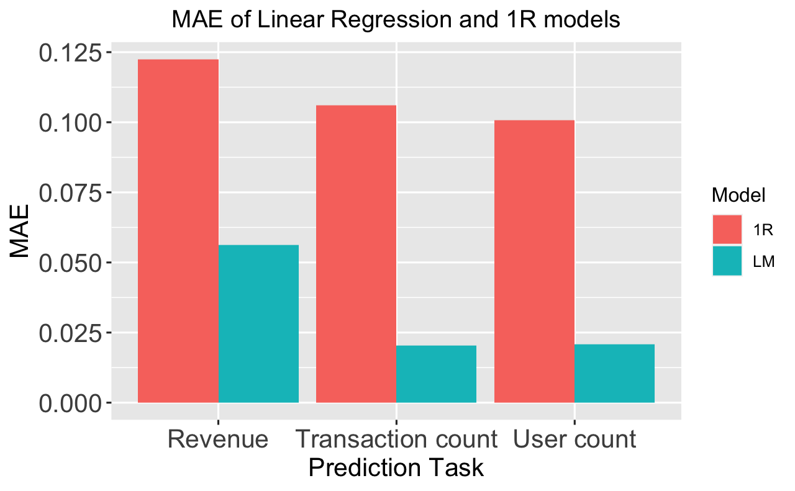
Forecast model: Linear Model
For each merchant, predict the total revenue, number of transactions and consumers during 2023, based on past data
＊ Due to lack of training data, time series model was not utilized to predict the 2023 data (12 months ahead)
Feature set:
the lower the better
Category of merchant
Take rate
Revenue level of merchant
Demographic / Income features of the consumer base
Normalized Error

Slide 20
2. Fraud detection model: Random Forest Classifier
Classify whether the transaction is suspicious or not
＊ Suspicious transaction is defined to be the one with fraud probability over 50% to ensure sufficient sample size with true (suspicious) labels
Feature set:
 | Precision | Recall
Merchant fraud detection model | 0.97 | 0.64
Consumer fraud detection model | 0.87 | 0.79
Datetime
Merchant details
Consumer details
Demographic / Income features of consumer
Precision is more important than accuracy and recall
Notes:
The results from both models can be used to optimize fraud prevention for each merchant. Merchants can prioritize and allocate more resources on additional security and protection measures.

Slide 21
Ranking system
03
What we found so far

Slide 22
Heuristics 1/2: Performance measures
1. Predicted Gain
2. Predicted number of consumers
3. Predicted number of transactions
Predicted Gain =
take rate × predicted revenue
Measure of profitability. Most important measure.
Measure of future potential. Also relates to usage rate of BNPL service.
Measure of demand. Frequent transactions imply that there is a high demand towards the merchant’s business.

Slide 23
Heuristics 2/2: Safety measures
4. Reliability of the merchant
5. Reliability of consumer base
How reliable is the merchant concerning fraudulent transactions.
How reliable is the consumer base concerning fraudulent transactions.
# of suspicious transactions by a merchant or a consumer
＊ Reliability = 1 -
# of all transactions by a merchant or a consumer

Slide 24
Our ranking system
Steps:
Normalise each feature values
Calculate the weighted sum for each merchant
Sort merchants by the weighted sum
Merchant rating = Σ weight × normalized features

Slide 25
Distribution of weights
40%
＊ Order of priority was determined upon our research,
weight values can be adjusted with specific needs or business goals
total gain
25%
25%
# consumers
# transactions
5%
5%
Merchant reliability
Consumer reliability

Slide 26
Result &
Recommendation
04

Slide 27
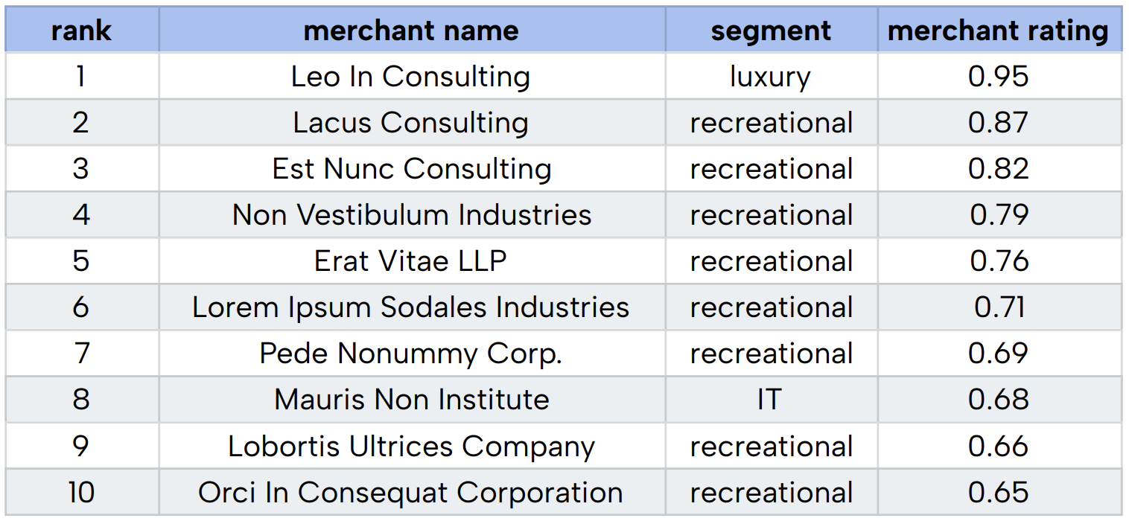
Results: top 10 out of 100 selected merchants

Slide 28
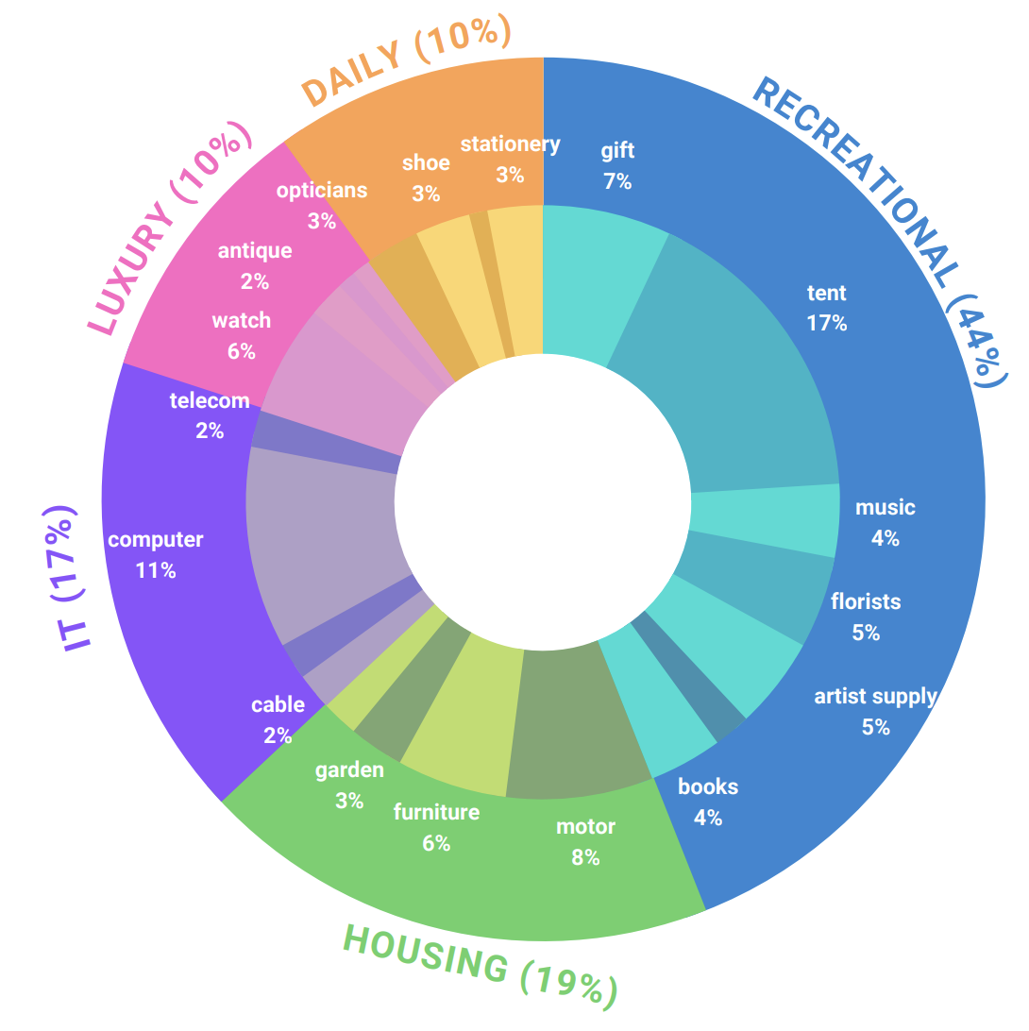
Top 100 merchants: by Segments and Categories
Top Segments:
Recreation (44%): The most common segment in the top 100 merchants
Housing (19%): The second most common segment, frequent transactions are being made
Top categories:
Tent (17%): large amount of transactions
Computer (11%): high average gain for single transaction
Inner circle: proportion by category
Outer circle: proportion by segments

Slide 29
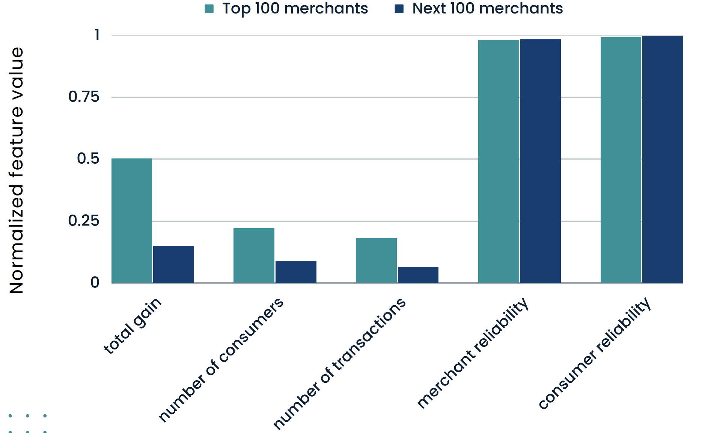
To what extent did the features differentiate the merchants?
Not much difference
→Indicates that top 200 merchants are mostly trustful
The first 3 features made big difference from top merchants and others
×3
×2
×2.5

Slide 30
$ 23,000,000
> 24,000
> 3,700,000
Top 100 merchants under our solution …
Predicted total gain for next year:
Predicted total number of consumers:
Predicted total number of transactions:
With all merchants having reliability score greater than 0.99.

Slide 31
Worth pursuing?
Multi-criteria ranking system
Ease of customization
Feasibility
Rather than using single measure, our ranking system takes into consideration about multiple important features for the company’s sustainable growth and safety.
Both the forecast model and the fraud detection model runs under feasible amount of time. (i.e. < 15 minutes)
Depending on the company goals / market situation, the feature weights are easily customizable.

Slide 32
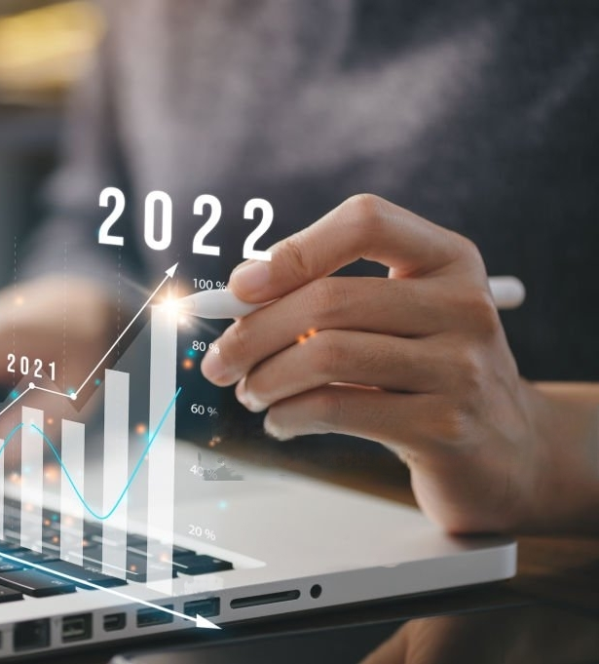
Conclusion
Choice of merchants is crucial for the growth of the firm
Our solution provides a framework indicating merchants with greatest profitability and safety
The models can be further refined upon the accumulation of data over years

Slide 33
Thanks!
Do you have any questions?

Slide 34
Appendix 1: Merchant segments and categories
 | Segment | Category
1 | Recreational | Hobby, books, tent, gift, music, florists, artist supply
2 | Housing | Equipment, furniture, garden, bicycle, motor
3 | IT | Computer, telecom, cable, digital
4 | Luxury | Antique, art, jewellery, watch
5 | Daily | Health, shoe, stationery, opticians

Slide 35
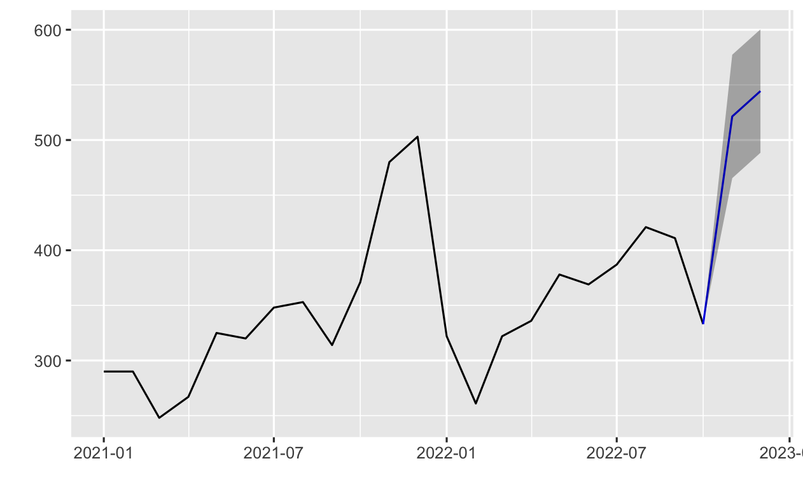
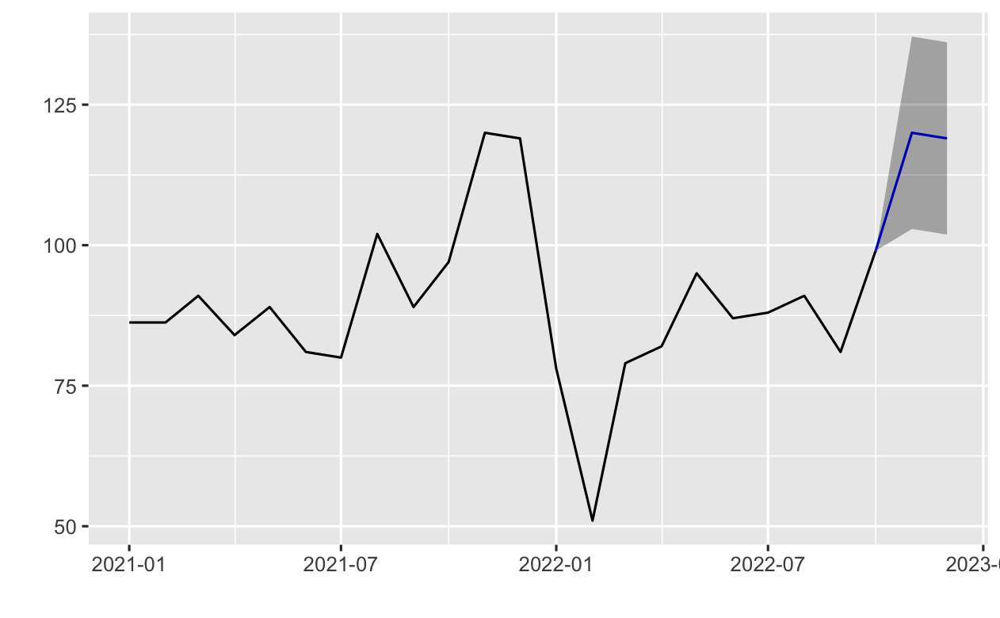
Appendix 2: missing months imputation with ARIMA Model
Data from 2022/11~12 has been imputed
Ex: total user count imputation for 2 merchants

Slide 36
Appendix 3: Linear Model performance
Model | MAE | Adj R-squared | P-value
Revenue prediction | 17606.85 | 0.9975 | < 2.2e-16 ***
User count prediction | 38.76 | 0.9999 | < 2.2e-16 ***
Transaction count prediction | 40.25 | 0.9999 | < 2.2e-16 ***

